Slide 1

Bank Marketing product Prediction
Objectives : A client would subscribe to the product or not.
Software Used : Anaconda, VSCode
Algorithm Used : K Nearest Neighbour
Dataset Used : Training_test_label.csv
Data Preprocessing Techniques : Labelling String values using Label Encoder

Slide 2
Problem Statement
Develop a model that has the capacity of predicting weather the person will subscribe or not.
Algorithm Used: K Nearest Neighbour
K-Nearest Neighbors (KNN) is a straightforward machine learning algorithm used for classification and regression. It predicts outcomes for new data points based on the majority class or average of the 'k' nearest neighbors in the feature space, using metrics like Euclidean distance. KNN is easy to understand and doesn't require a training phase. While it works well for smaller datasets with clear patterns, it can be computationally expensive for larger datasets and is sensitive to feature scales. It finds applications in recommendation systems, image recognition, and medical diagnosis.

Slide 3
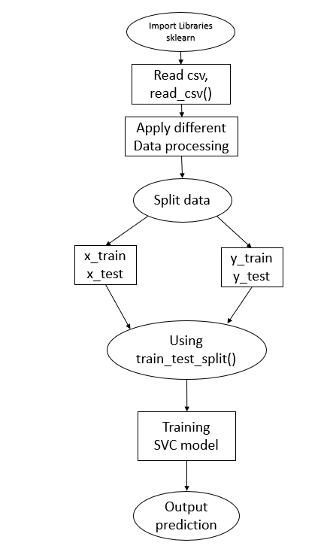
Approach Used:

Slide 4
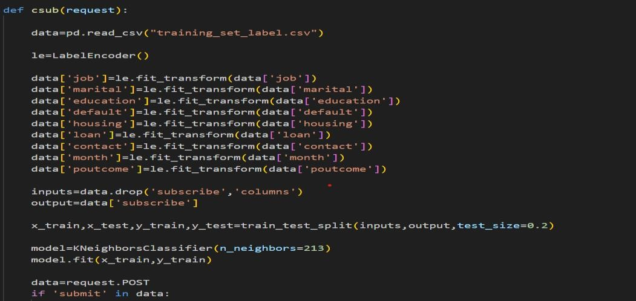
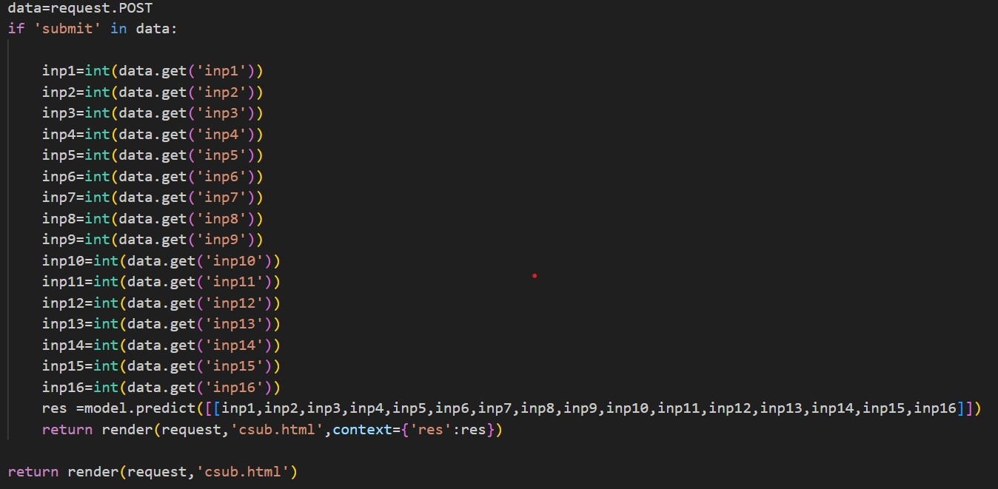
CODE

Slide 5
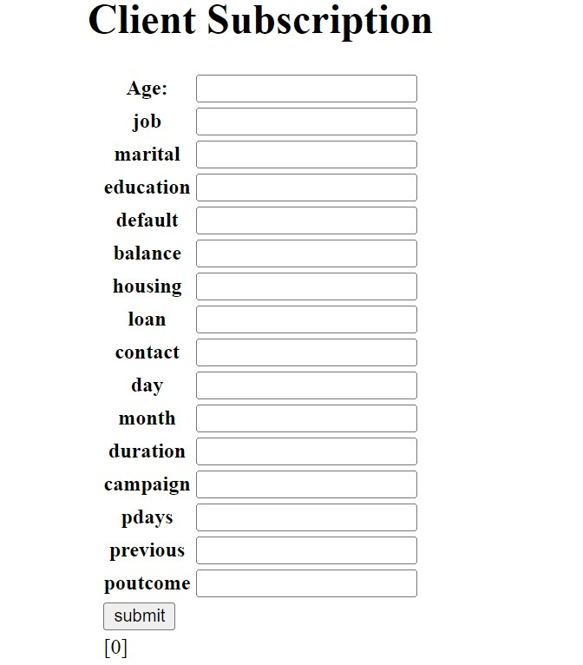
OUTPUT

Slide 6

THANK YOU

